Slide 1
Capstone Project
Play Store App Review Analysis
By
Ankita Gupta

Slide 2






WHY ANALYZE THE GOOGLE PLAY STORE?
Mobile App Market is set to grow 20% by 2023
Android Apps comprise 90% of the Mobile App Market
What makes an App popular? Can we predict how popular it’s going to be?
What are some interesting patterns in user behavior related to app usage & feedback?

Slide 3
Introduction
Android is the most popular operating system in the world, with over 2.5 billion active users spanning over 190 countries.
Google Play was launched on March 6, 2012,bringing together Android Market marking a shift in Google's digital distribution strategy .
The Google Play Store is the largest and most popular Android app store.
There are more than 3.04 million apps found on Google Play Store.
The Play Store apps data has enormous potential to drive app-making businesses to success.
Actionable insights can be drawn for developers to work on and capture the Android market. The main goal of our project is-
The purpose of our project is to gather and analyze detailed information on apps in the Google Play Store in order to provide insights on app features and the current state of the Android app market.
The Objective of the project to Explore and analyze the data to discover key factors responsible for app engagement and success.

Slide 4
Problem Statement
Two datasets are provided, one with basic information and the other with user reviews for the respective app.
We must examine and evaluate the data in both datasets in order to identify the important characteristics that inﬂuence app engagement and success.
So, what factors inﬂuence an app's success?
An app is said to be successful if it has:
A high average user rating
A good number of positive reviews
A good number of monthly average users
High revenue per customer and so on.

Slide 5
Agenda
Introduction
Category wise play store apps installs
Category wise most popular apps
Top 10 apps in play store considering all the parameters
Average installs, category wise
Most installed apps in communication category
Category wise percentage of paid apps
Category wise top installed paid apps
Average rating of paid apps
Correlation between Rating ,Installs and Price
Category wise installed apps with content rating
Percentage reviews sentiment distribution

Slide 6
Dataset Preparation
Loading the data sets: Two datasets, First Play store app
dataset and User Reviews dataset.
Import Libraries: NumPy, Pandas, Seaborn and Matplotlib
Data cleaning: Null values, Finding and removing Outliers, Removing duplicate data.
Data Imputation: Filling the missing categorical values with mode and numerical values with median. Conversion of price, installs, reviews into numerical values.
Exploratory Data Analysis: Analyzing the data sets to summarize their main characteristics using statistical graphics and data visualizations method.

Slide 7
1.App : This column Contains the name of the app for each observation. 2.Category : This column Contains Category to which the app belongs. 3.Rating : This column contains the average rating for the app. 4.Reviews : This column contains the number of reviews that the app has received on the play store. 5.Size : This column contains the amount of memory the app occupies on the device. 6.Installs : This column contains the number of times that the app has been downloaded and installed from the play store. 7.Type : This column contains the information whether the app is free or paid. 8.Price: If the app is a paid app, this column contains the data about its price. 9.Content Rating: This column contains the maturity rating of the app i.e. the age group of the audience for which it is suitable. 10.Genres: This column contains the data about to which genre the app belongs. Genres can be considered as a further division of the group of Category. 11.Last Updated: Contains the date on which the latest update of the app was released. 12.Current Version: Contains information on the current version of the app available on the play store. 13.Android Version: Contains information about the android versions on which the app is supported.
Attributes in Google Play store Data

Slide 8
Attributes in User reviews
App- Application name
Translated Review- User review
Sentiment- Positive/Negative/Neutral
Sentiment Polarity- Sentiment polarity score
Sentiment Subjectivity- Sentiment subjectivity score

Slide 9



OVERVIEW OF ANALYSIS
Data Cleaning
Data Exploration
Predictive Modeling
Understand the structure of the dataset and clean data before analysis
Uncover initial patterns, characteristics, and points of interest using visual exploration
Formulate a statistical model to forecast an outcome using relevant predictors

Slide 10
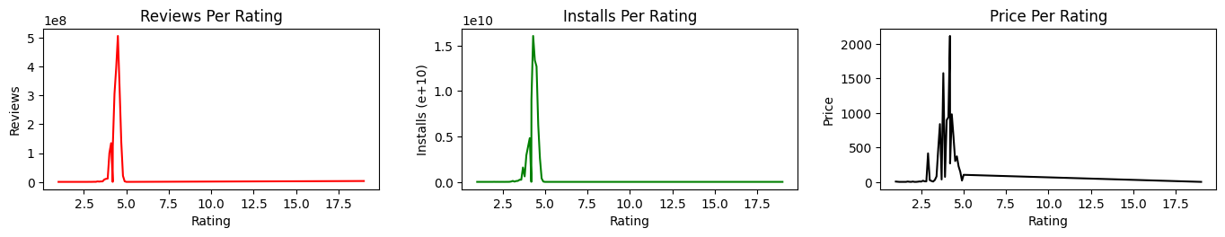
Pairwise Plot- Reviews, Installs, Price
From the above plottings, we can imply that most of the apps with higher rating range of 4.0 - 4.7 are having high amount of reviews and installs. In terms of price, it doesn't reflect a direct relationship with rating, as we could see a fluctuation in term of pricing even at the range of high rating.

Slide 11
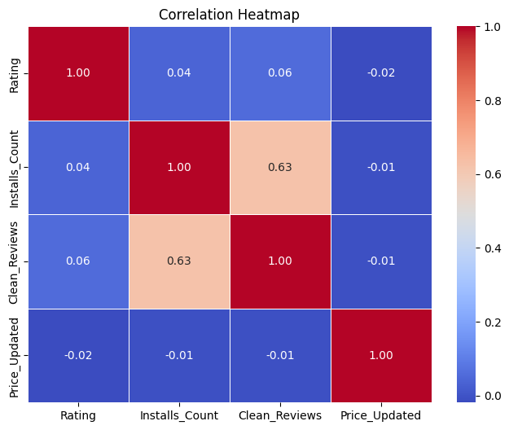
Correlation Heatmap
There is a strong positive correlation between the Reviews and Installs.
The Price is slightly negatively correlated with the Rating, Reviews and Installs.
Rating is slightly positively correlated with the Installs and Reviews.

Slide 12
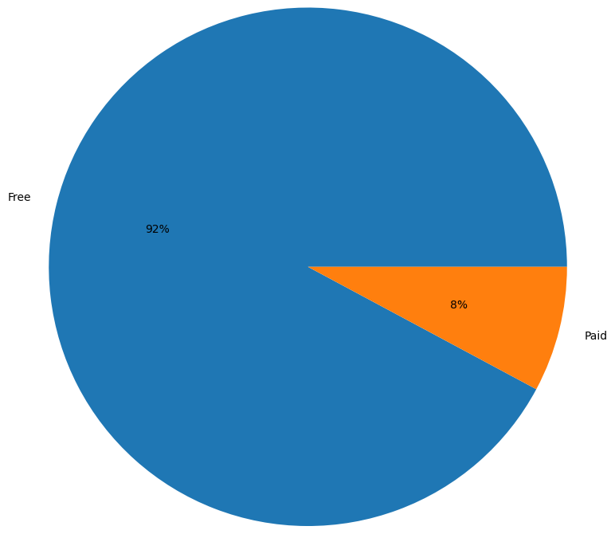
Percentage of Paid apps v/s Free apps
We Observed that 92% of Apps are free and only 8% of Apps are paid in Play store.

Slide 13
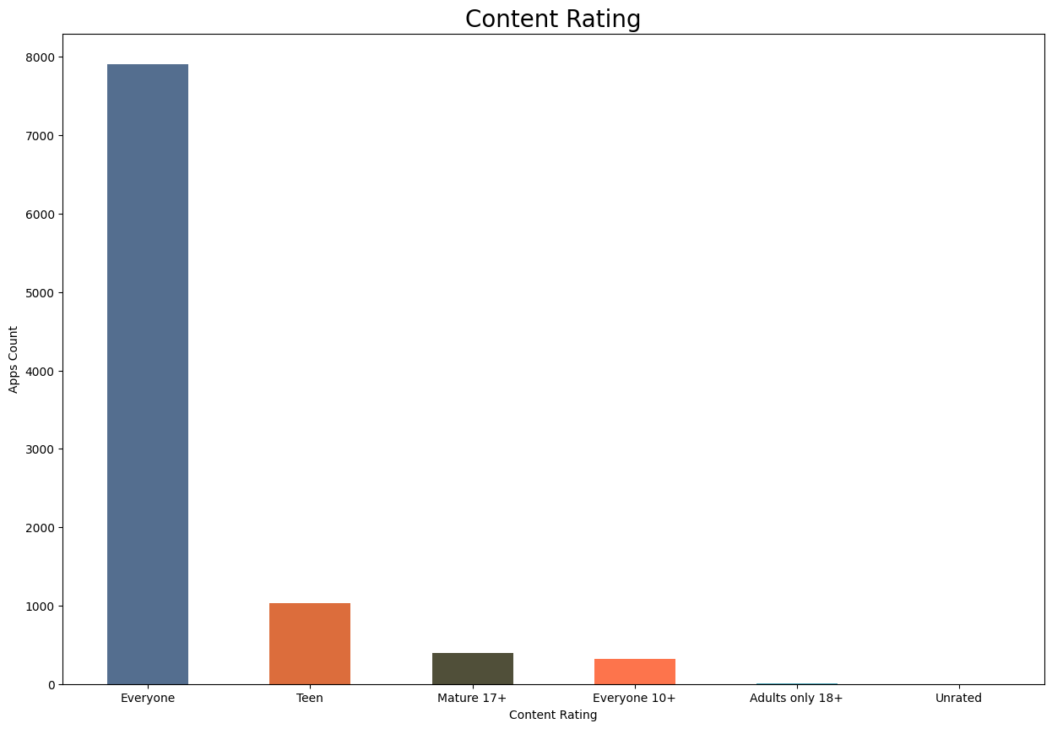
Content Rating
From the above plot we can see that Everyone category having majority of apps count.
A majority of the apps (81.80%) in the play store are can be used by everyone. The remaining apps have various age restrictions to use it.

Slide 14
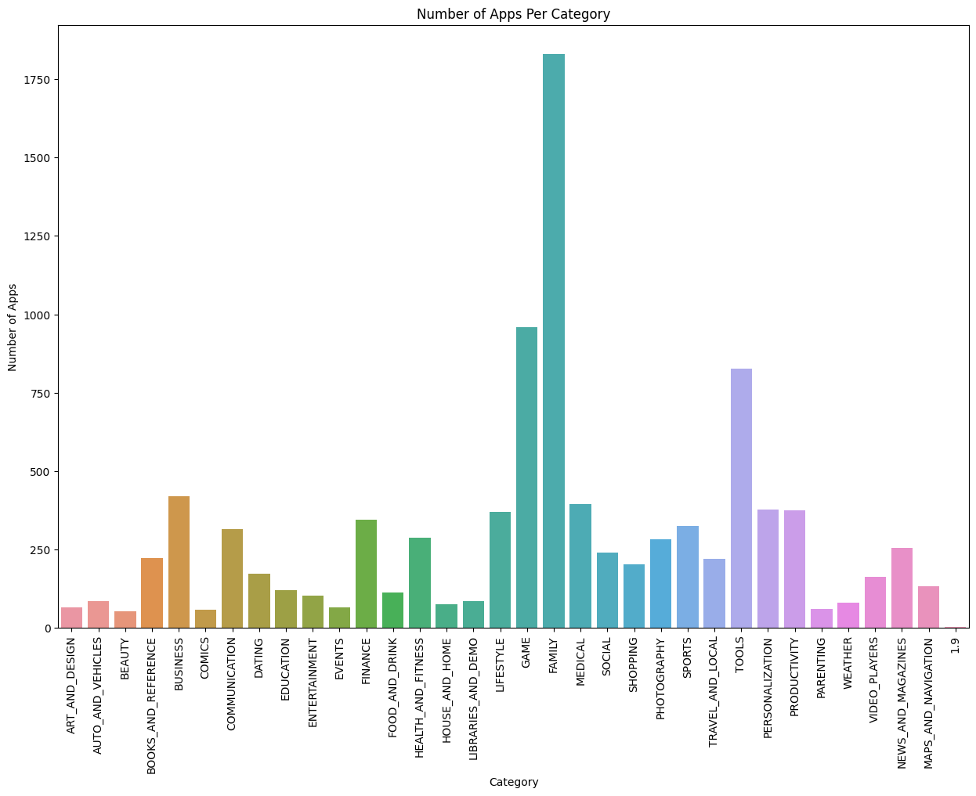
Count of Applications in each category
Family and Game apps have the
highest market prevalence. Surprising Tools, Business and Medical apps are also at the Top Count of applications.

Slide 15
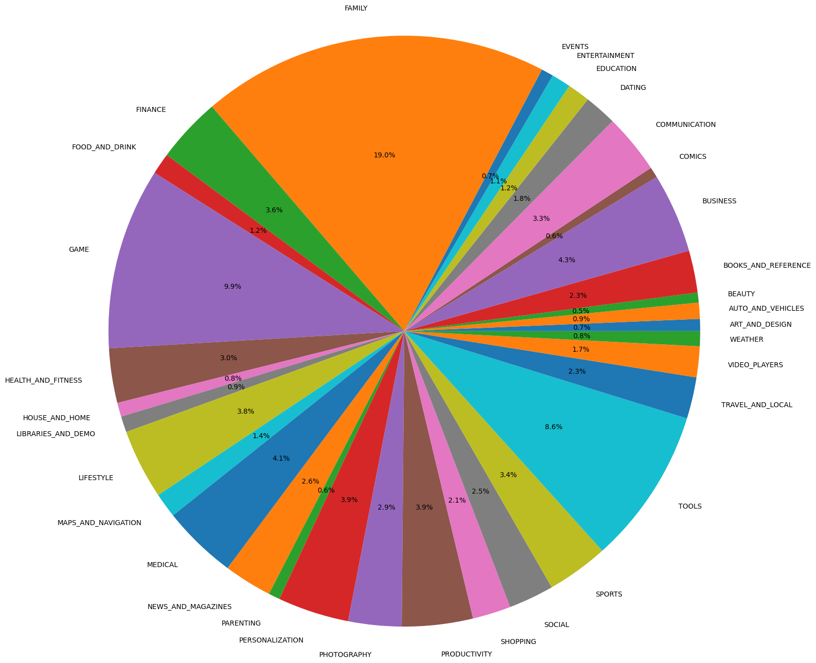
Percentage of Applications in each category

Slide 16
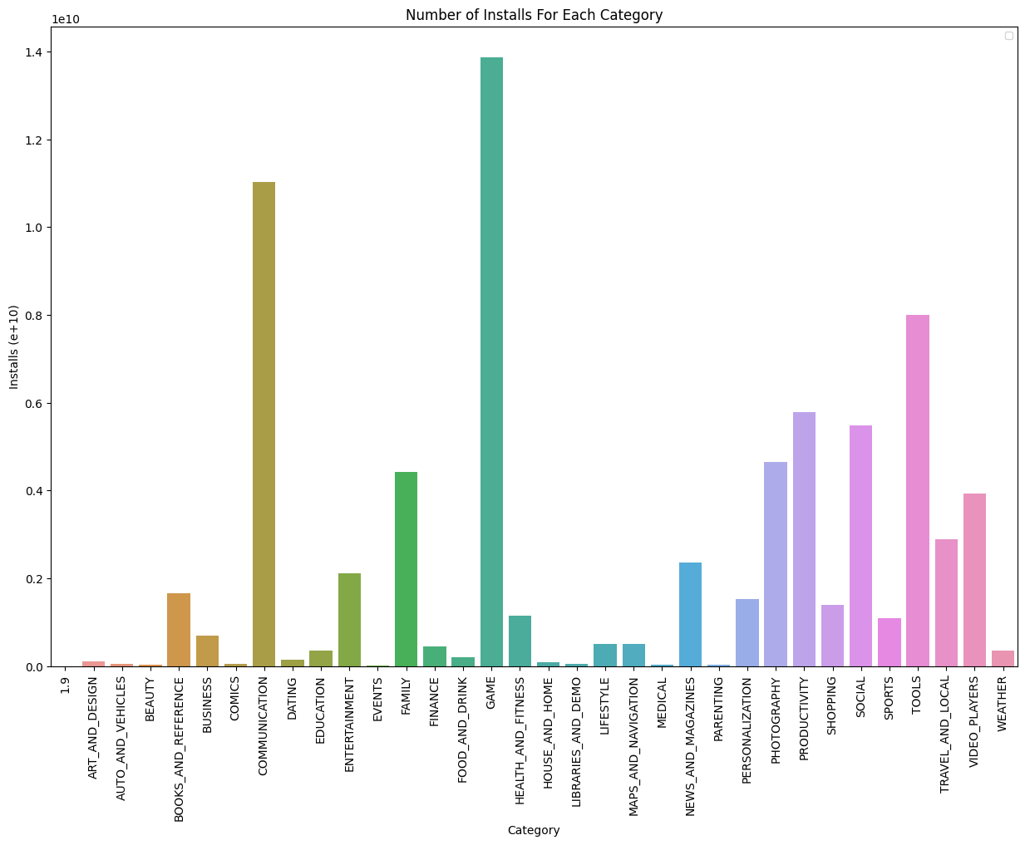
Category App's have most number of installs
The Game, Communication and Tools categories has the highest number of installs compared to other categories of apps.

Slide 17
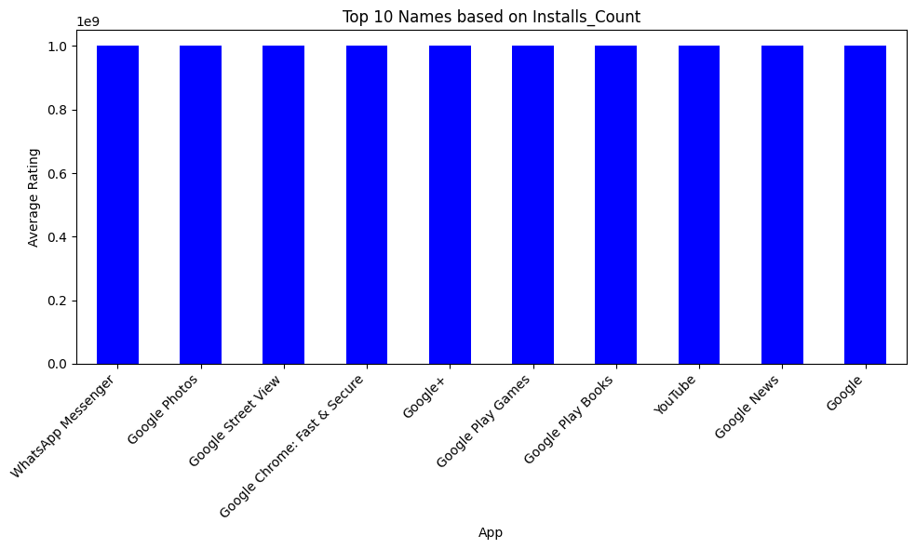
Top 10 most installed apps in any category
This graph shows the top 10 most installed apps are WhatsApp Messenger, Google Play Books, Subway Surfers, Maps - Navigate & Explore,Gmail,Instagram,Facebook,Google Chrome: Fast & Secure,Google+,YouTube.

Slide 18
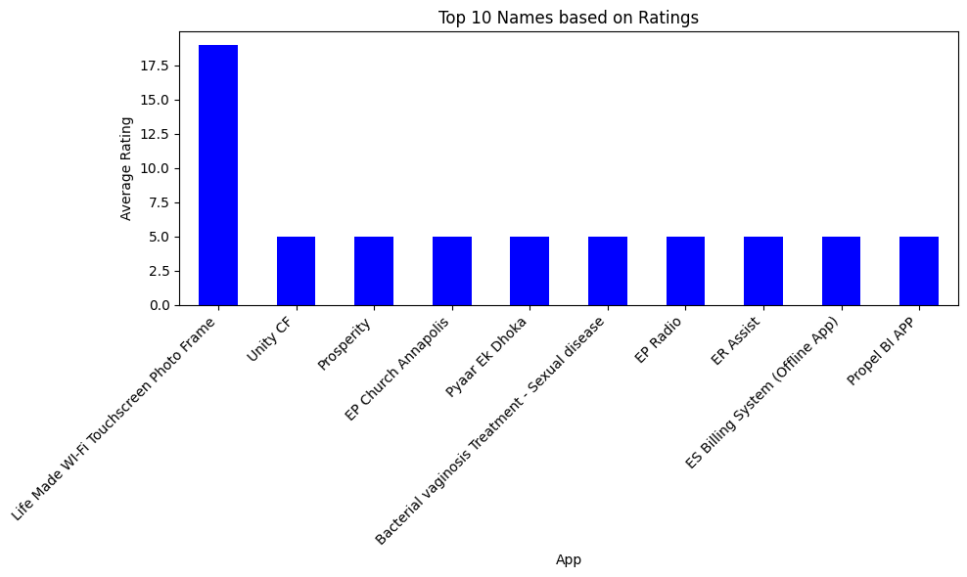
Top 10 apps based on Ratings

Slide 19
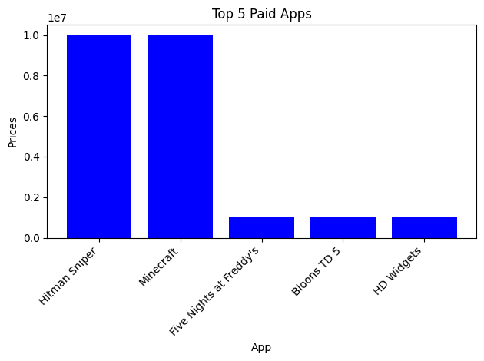
Top 5 paid most installed app
Hitman Sniper, Minecraft, Five Nights at Freddy’s, Bloons TD 5, HD Widgets are the top paid most installed apps based on revenue generated.

Slide 20
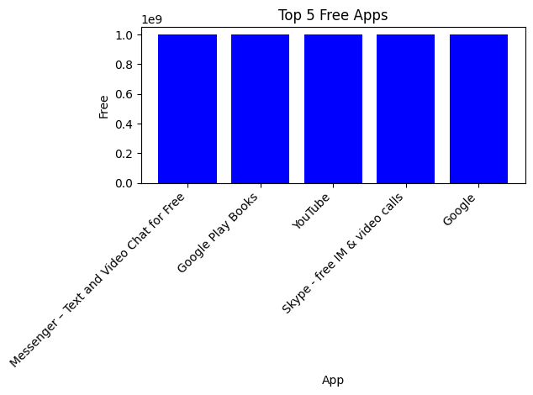
Top 5 free most installed
Messenger – Text and Video Chat for Free
Google Play Books,
YouTube
Skype - free IM & video calls,
Google

Slide 21
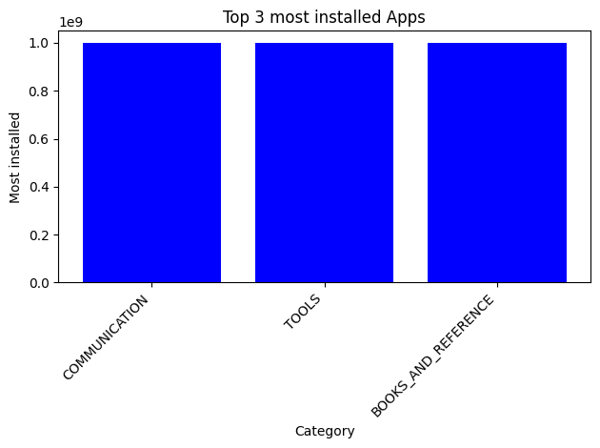
top 3 most installed application category
COMMUNICATION,BOOKS_AND_REFERENCE and TOOLS are the type of top 3 most installed applications.

Slide 22
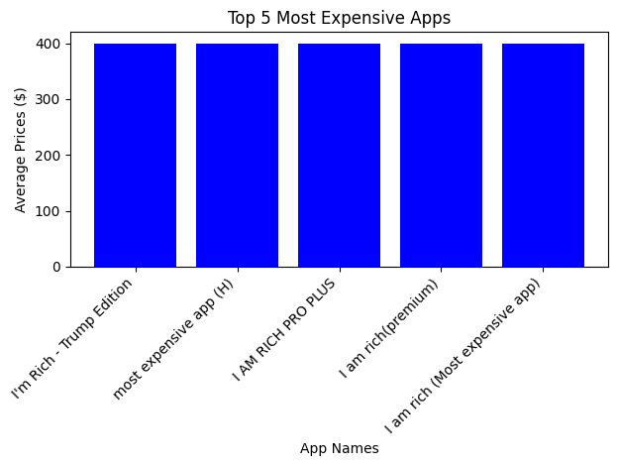
Top 5 Most Expensive Apps
1.I'm Rich - Trump Edition,
2.most expensive app,
3.I am rich(premium),
4.I am Rich!,
5.I AM RICH PRO PLUS
are the top 5 most expensive apps.

Slide 23
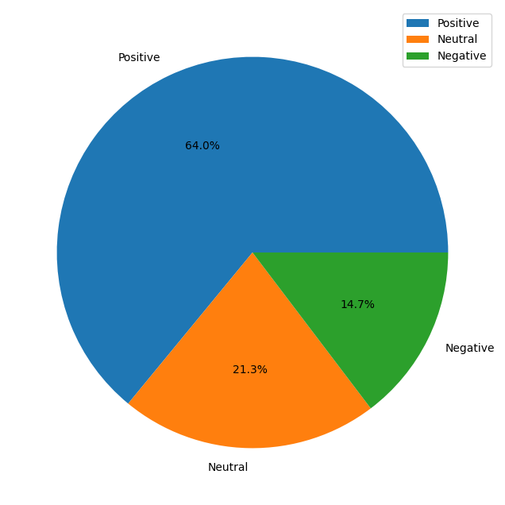
Percentage of Review Sentiments
The number of Unique Apps from Play store and User reviews merged dataset are 816.
From Sentiment column, 64% are Positive, 21.3% are Negative and 14.7% are Neutral values.

Slide 24
Challenges Faced
Challenges Faced
Reading the dataset and comprehending the problem statement.
Examining the business KPIs for app development and devising a solution to the problem.
Handling the error, duplicate and NaN values in the dataset.
Designing multiple visualizations to summarize the information in the dataset and successfully communicate the results and trends to the reader.

Slide 25
Conclusion
92.19% apps are Free and 7.81% apps are paid in type.
There are various categories amongst which there are multiple applications- Three major apps are Family, Tools and Games.
• Applications receive both Ratings and Reviews and can be respectively graded too.
• Applications are installed by various users and mostly installed applications can be found, along with the information of their category, rating, type etc.
• Business, Game, Family and Tools have the highest number of applications.
• Free applications make 98% of the total of Applications, with a total count of more than 8000.
• Communication, Games and Tools are the most installed Application category.

Slide 26
Conclusion[Contd.]
Communication, Games and Tools are the most installed Application category.
• Most of the apps with higher rating range of 4.0-4.7 are having high amount of reviews and installs. In terms of price, it doesn't reflect a direct relationship with rating, as we could see a fluctuation in term of pricing even at the range of high.
• Install Counts and Reviews are the most correlated and influence a lot of the downloads.
Thus a lot of factors play an important role in the user usage and popularity of any application. It can be because of the price of the application, based of the rating and reviews, also because of the number of installs, which in turn also affects the decision making of any app.

Slide 27
Thank You

